Slide 1
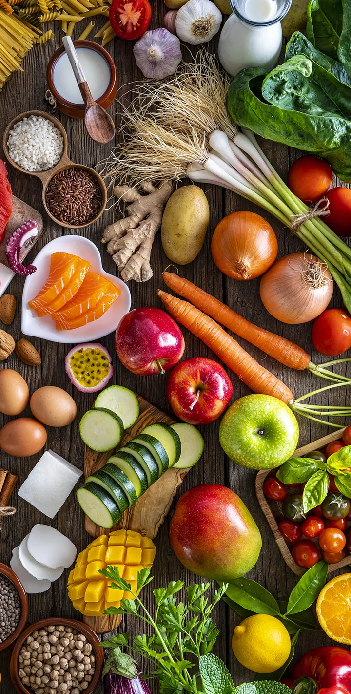

Cancer Survivors
&
Stress
What Does Nutrition
Have to Do With It?
Presented
By
Mireille Bright, PhD, RDN

Slide 2
Objectives:
What is cancer survivorship?
What are common stressors for cancer survivors?
Is there a relationship between cancer & stress?
What does nutrition has to do with anything?
  Nutrition for cancer prevention care
Discuss nutritional deficits in cancer survivors
Discuss nutritional myths related to cancer
Review nutritional recommendations for cancer survivors

Slide 3
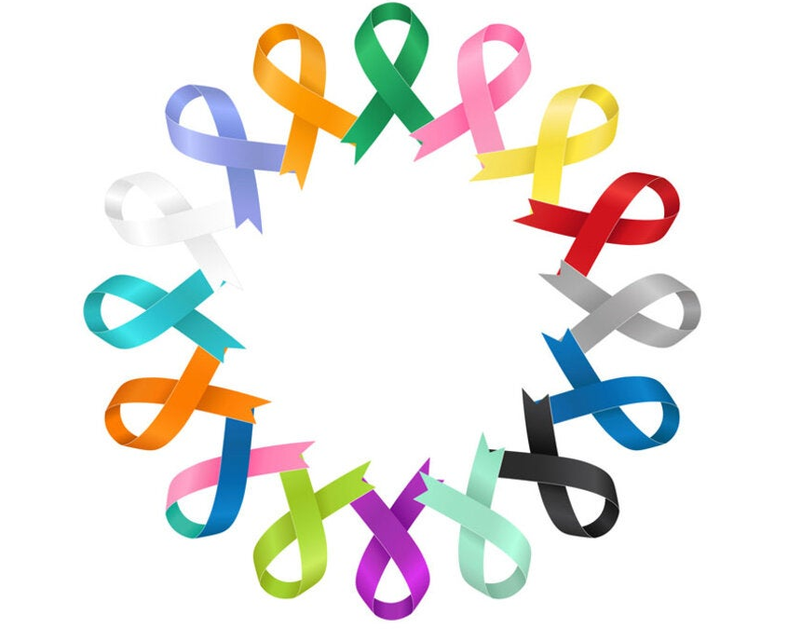
What is a Cancer Survivor?
A person is considered a Cancer Survivor from the moment they are diagnosed through the rest of their lives.
There are 3 stages of cancer survivorship:
              Acute: diagnosis → active treatment
              Extended: cancer free for months after treatment
              Permanent: cancer free for years
3

Slide 4
Can Stress Cause Cancer?
Chronic Stress can lead to health problems, but its connection to cancer is unclear:
A Case Study with Canadian men found an association between workplace stress and prostate cancer
Study with 100,000 women in the UK reported no association between breast cancer and perceived stress levels
A meta-analysis of 142 studies found that stress was associated with a higher incidence of lung cancer
Even when it appears that stress is related to cancer risk, it may be an indirect relationship.
4

Slide 5
Common Stressors for Cancer Survivors
Process to a diagnosis
Complex, multi-step treatment plans
Fear of recurrence
Financial burdens, especially in patients with lower socioeconomic status
How does stress affect people who have cancer?
Stress → Glucocorticoids → Apoptosis +
Metastasis + Resistance to Chemotherapy
5

Slide 6
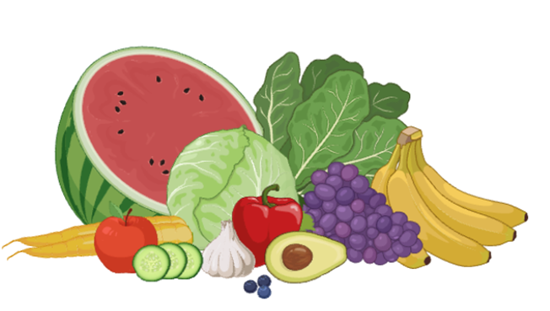
What does nutrition has to do with anything?

Slide 7
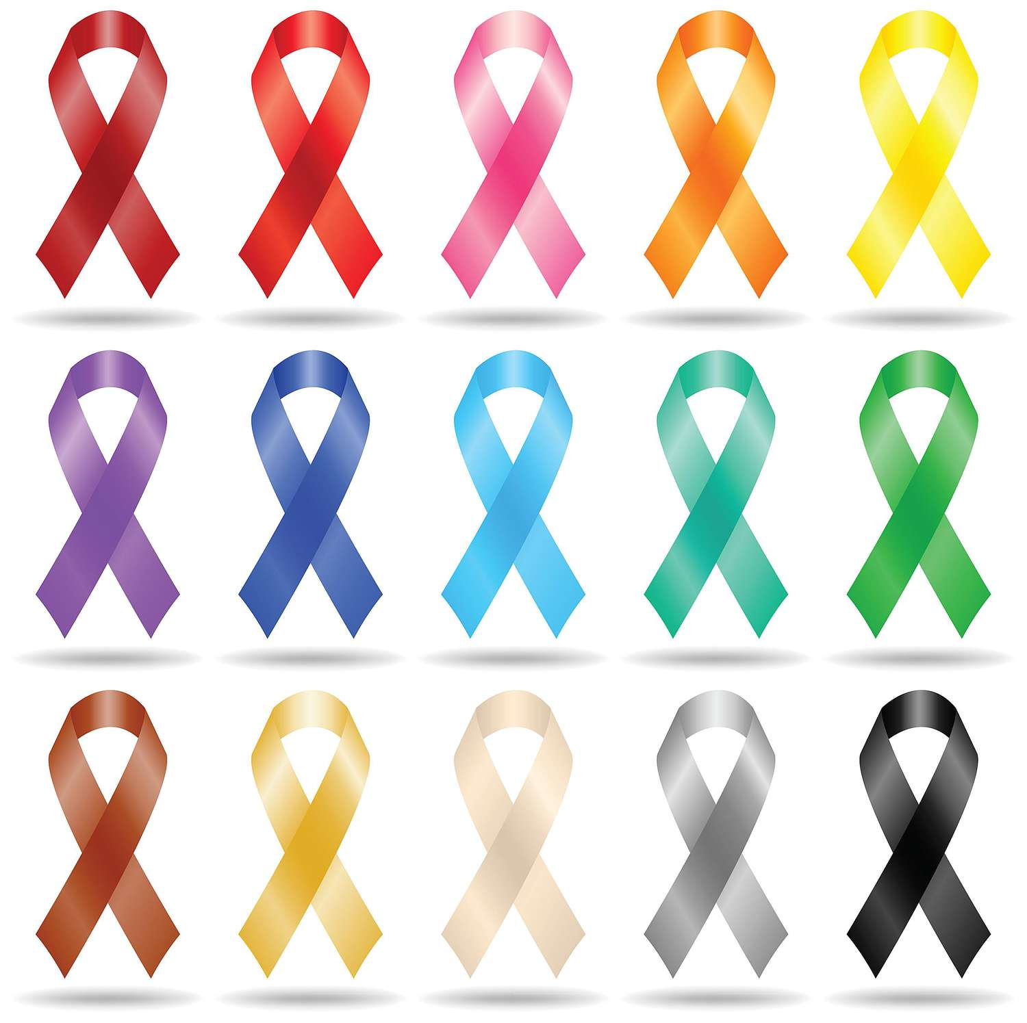
Common Nutritional Deficits in Cancer Survivors
Nutritional challenges can vary based on the cancer type:
Obesity negatively impacts Breast Cancer survivors
Malnutrition and Weight Loss negatively impact Lung Cancer survivors
Malnutrition, Weight Loss, and Muscle Loss negatively impact Colorectal Cancer survivors
7

Slide 8
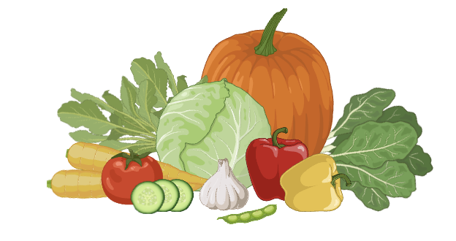
Nutrition as Cancer Prevention?
A diet that consists mostly of fruits and vegetables with limited dairy, red meat, processed food, and alcohol has been show to help regulate cell cycle progression and prevent cancer.
A diet that consists mostly of fruits and vegetables with limited dairy, red meat, processed food, and alcohol has been show to help prevent cancer.
8

Slide 9



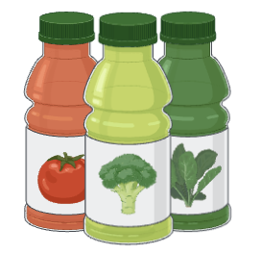
Nutrition and Cancer Myths:
Eliminating Sugar will “starve” cancer cells.
Eating fat makes you fat.
Frozen produce isn’t as healthy as fresh produce.
Juice cleanses and detoxes are good for you.
9
Bulleted Text Style Title—
Helvetica Neue 20pt Bold

Slide 10




Nutrition and Cancer Myths (cont.):
You can prevent cancer with superfoods.
Eating late at night causes weight gain.
If you exercise, you can eat whatever you want.
Steer clear of carbs.
10
Bulleted Text Style Title—
Helvetica Neue 20pt Bold
Notes:
Add a summary slide after with all of the myths and the correct answer

Slide 11
Nutrition and Cancer Myths Summary:
Eliminating sugar will "starve" cancer cells
  Truth: Sugar feeds all cells, including cancer cells
Eating fat makes you fat
  Truth: All unburned calories will be stored as fat
Frozen produce isn’t as healthy as fresh produce
  Truth: Sometimes frozen produce can be more nutritious
Juice cleanses and detoxes are good for you
  Truth: Juices can cause nausea, headaches, and low energy
You can prevent cancer with “superfoods”
  Truth: Superfoods alone cannot protect you from cancer
Eating late at night causes weight gain
  Truth: The time of day does not affect your weight, your caloric intake does
If you exercise, you can eat whatever you want
  Truth: Exercise alone cannot prevent weight gain and associate cancer risk
Steer clear of carbs
  Truth: Your body needs energy from carbohydrates, but the source matters

Slide 12
Nutrition Recommendations for Cancer Prevention
Achieve and Maintain a healthy weight throughout life.
Follow a Healthy Eating Pattern:
INCLUDE:
Foods high in nutrients
Variety of vegetables
Fruits
Whole grains
AVOID:
Red and processed meats
Sugar-sweetened beverages
Highly processed foods
Refined grain products
Avoid Alcohol
Be Physically Active

Slide 13


Slide 14
Sources:
Wiseman, M. J. (2019). Nutrition and cancer: prevention and survival. British Journal of Nutrition, 122(5), 481-487.
Cordova, M. J., Riba, M. B., & Spiegel, D. (2017). Post-traumatic stress disorder and cancer. The Lancet Psychiatry, 4(4), 330-338.
Mayer, D. K., Nasso, S. F., & Earp, J. A. (2017). Defining cancer survivors, their needs, and perspectives on survivorship health care in the USA. The Lancet Oncology, 18(1), e11-e18.
Mourouti, N., Panagiotakos, D. B., Kotteas, E. A., & Syrigos, K. N. (2017). Optimizing diet and nutrition for cancer survivors: A review. Maturitas, 105, 33-36.
Petrova, D., Ubago-Guisado, E., Garcia-Retamero, R., Redondo-Sánchez, D., Pérez-Gómez, B., Catena, A., ... & Sánchez, M. J. (2024). Allostatic load and depression symptoms in Cancer survivors: a National Health and Nutrition Examination Survey Study. Cancer Nursing, 47(4), 290-298.
Salas, S., Cottet, V., Dossus, L., Fassier, P., Ginhac, J., Latino-Martel, P., ... & Ancellin, R. (2022). Nutritional factors during and after cancer: impacts on survival and quality of life. Nutrients, 14(14), 2958.
Volden PA, Conzen SD. The influence of glucocorticoid signaling on tumor progression. Brain, Behavior, and Immunity 2013; 30 Suppl(0):S26–31.
He X-Y, Ng D, Van Aelst L, Egeblad M. Stressing out about cancer immunotherapy. Cancer Cell 2019; 36(5):468–470.
Moreno-Smith M, Lutgendorf SK, Sood AK. Impact of stress on cancer metastasis. Future Oncology 2010; 6(12):1863–1881.
National Cancer Institute. Stress and cancer. 2022. https://www.cancer.gov/about-cancer/coping/feelings/stress-fact-sheet
Blanc-Lapierre A, Rousseau M-C, Weiss D, et al. Lifetime report of perceived stress at work and cancer among men: A case–control study in Montreal, Canada. Preventive Medicine 2017; 96:28–35.
Blanc-Lapierre A, Rousseau M-C, Parent M-E. Perceived workplace stress is associated with an increased risk of prostate cancer before age 65. Frontiers in Oncology 2017; 7:269.
Schoemaker MJ, Jones ME, Wright LB, et al. Psychological stress, adverse life events and breast cancer incidence: A cohort investigation in 106,000 women in the United Kingdom. Breast Cancer Research 2016; 18(1):72.
Chida Y, Hamer M, Wardle J, Steptoe A. Do stress-related psychosocial factors contribute to cancer incidence and survival? Nature Clinical Practice Oncology 2008; 5(8):466–475.
Markham Heid. Food myths: 8 truths to help lower your cancer risk. The University of Texas, MD Anderson Cancer Center, 2014. https://www.mdanderson.org/publications/focused-on-health/food-truths-to-lower-cancer-risk.h18-1589046.html
American Cancer Society. American Cancer Society Guideline for Diet and Physical Activity. 2020. https://www.cancer.org/cancer/risk-prevention/diet-physical-activity/acs-guidelines-nutrition-physical-activity-cancer-prevention/guidelines.html

